Slide 1

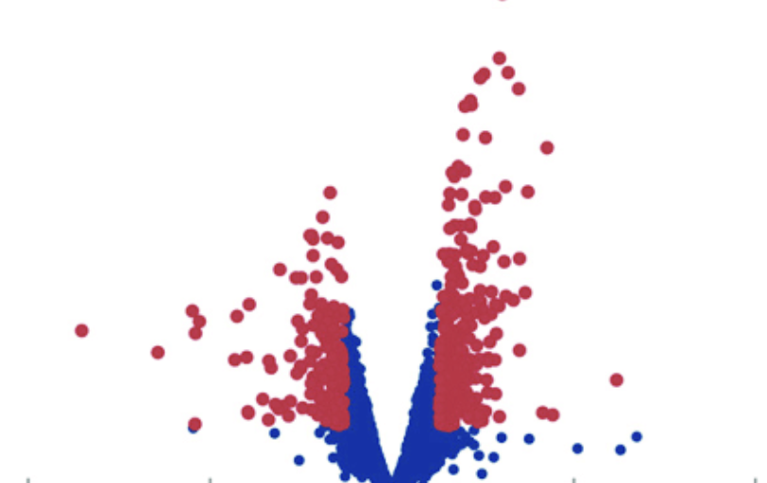
Using ChatGPT to develop the functional R code for the visualization of proteomic data volcano plot
Presented By
Tareque Muzahid Zamee and Md Mehadi Hasan Sohag
Date: April 25, 2024

Slide 2
What is Volcano Plot?
Scatter plot that is applied to quickly seek out changes in large data sets composed of replicated data
Plots fold-change versus significance on the x and y axes, respectively
Combines a measure of statistical significance from a statistical test with the changes in magnitude
Enabling quick visual determination of these data-points
Why in Proteomics?
Identification of significantly differentially expressed proteins
Highlighting substantial expression alterations
Understanding experimental context and conditions enhances accurate interpretation.
Pathway enrichment studies and other analyses to validate biological implications

Slide 3
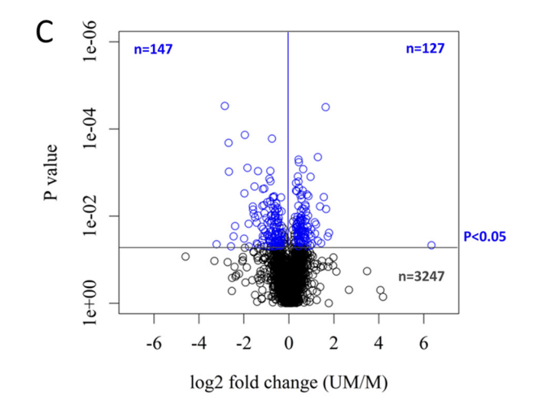

Isobaric tags for relative and absolute quantification (iTRAQ) Mass Spectrophotometry
To quantify two distinct forms of Chronic Lymphocytic Leukemia (CLL)
UM-CLL--- Unmutated Chronic Lymphocytic Leukemia (CLL)
M-CLL --- Mutated Chronic Lymphocytic Leukemia (CLL)
Total Identified Proteins : 3521
Similar Level Expression : 3247 (92%)
Up-regulated : 127
Down Regulated: 147

Slide 4
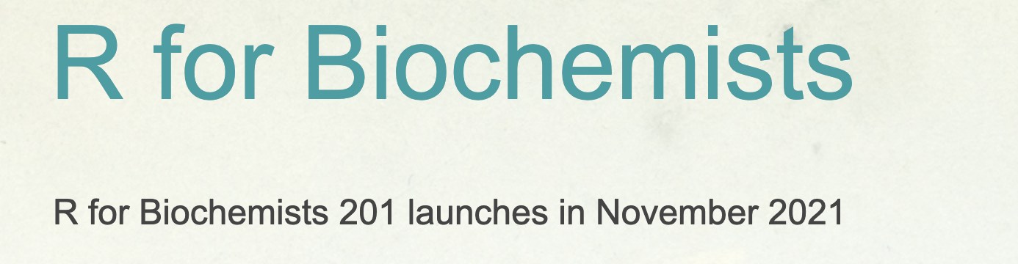
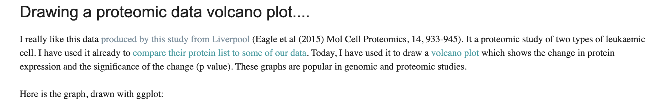
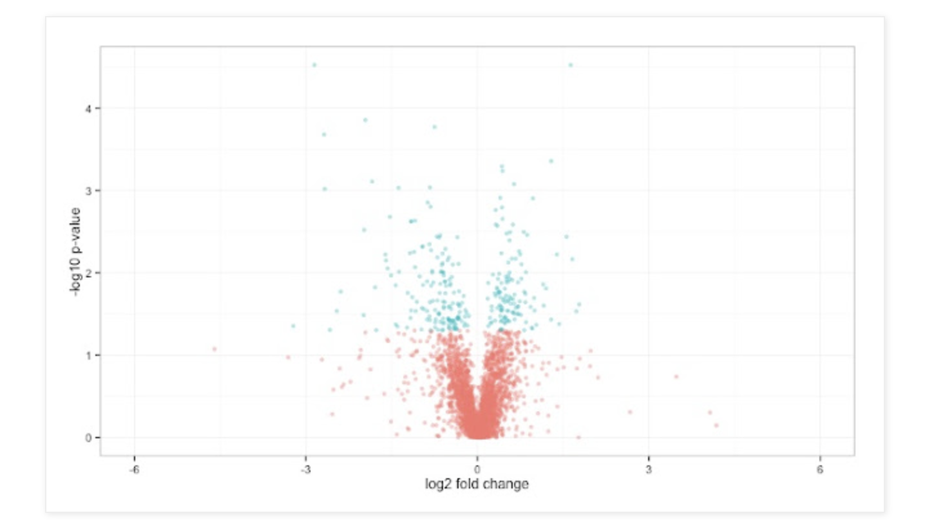
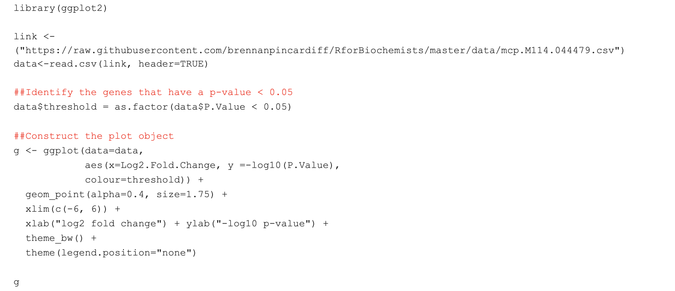
Functional R code for generating the proteomics volcano plot

Slide 5




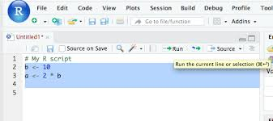
Case Study Workflow
Get a functional R code using the using the Eagle et al (2015) Mol Cell Proteomics, 14, 933-945
Ask ChatGPT to get the functional code by feeding the dataset
An article with protein expression in volcano plot
Ask ChatGPT again and again until the working code will be found
Create a GitHub repository and upload all the required file for this case study
ChatGPT responses will be saved in to .txt file and Code files will be saved into .R file
ChatGPT will try to provide the working code

Slide 6
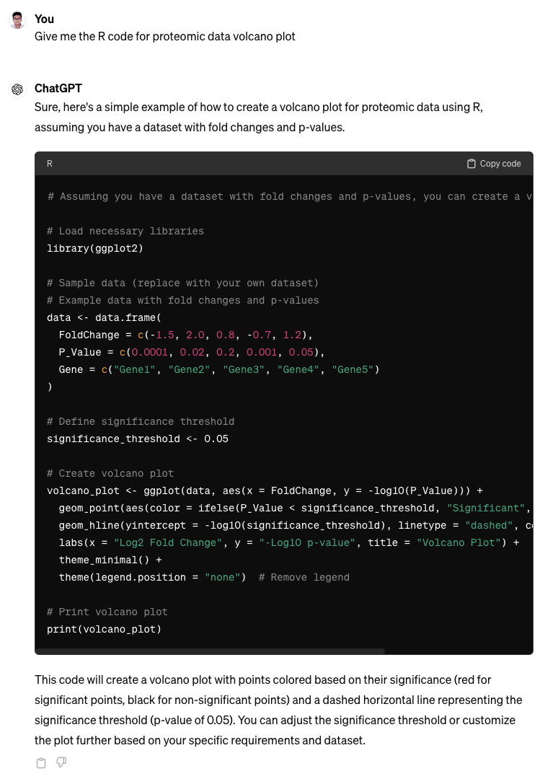
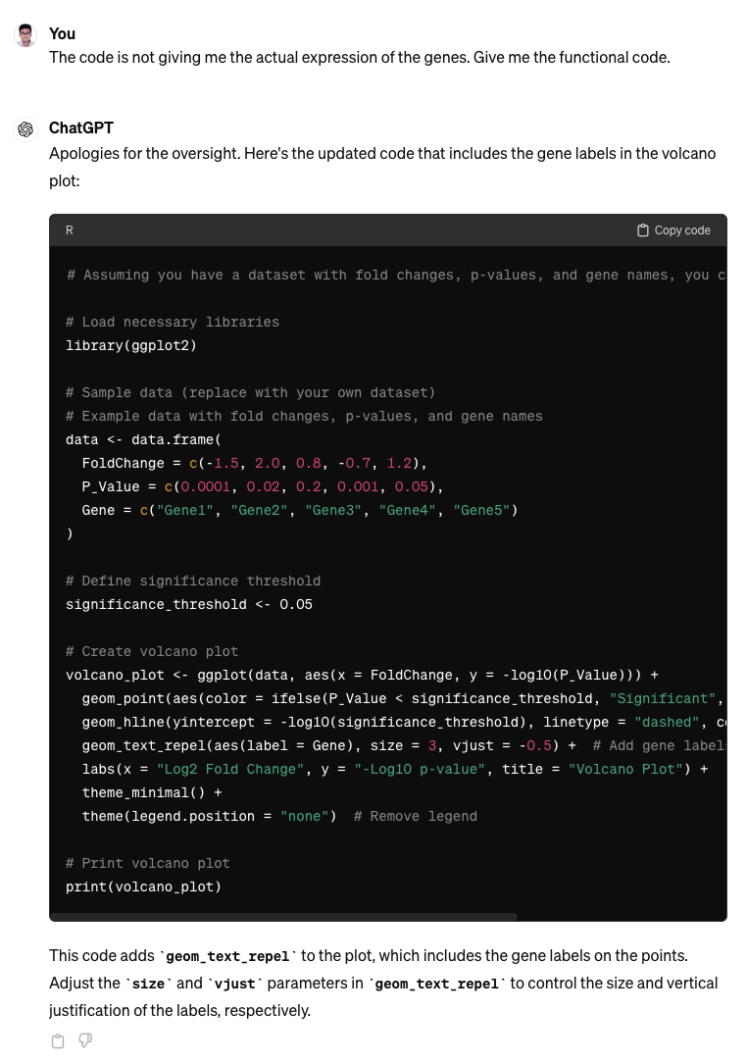
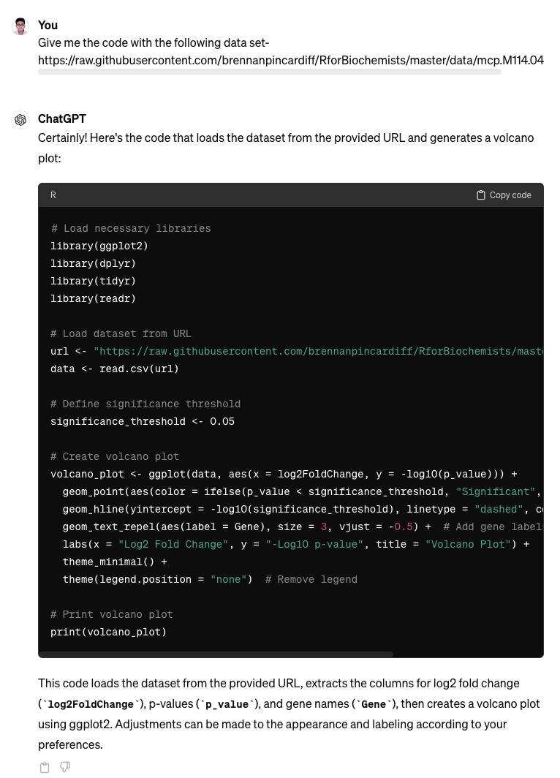

Slide 7
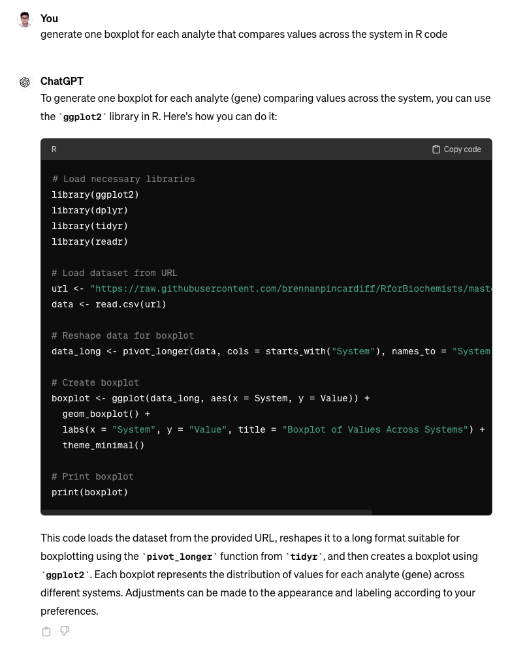
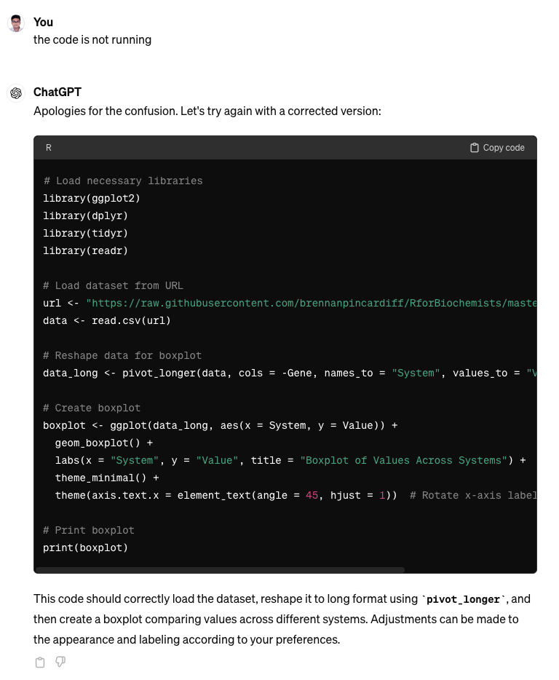
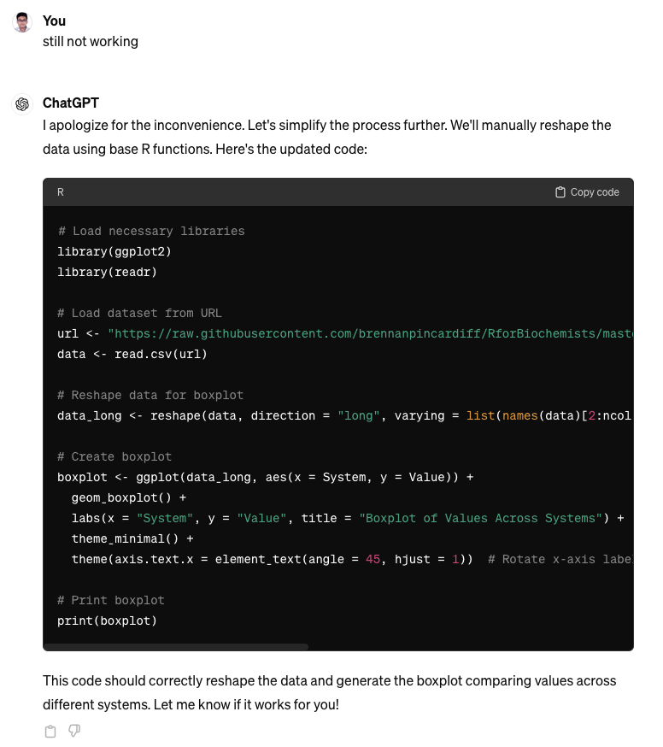

Slide 8
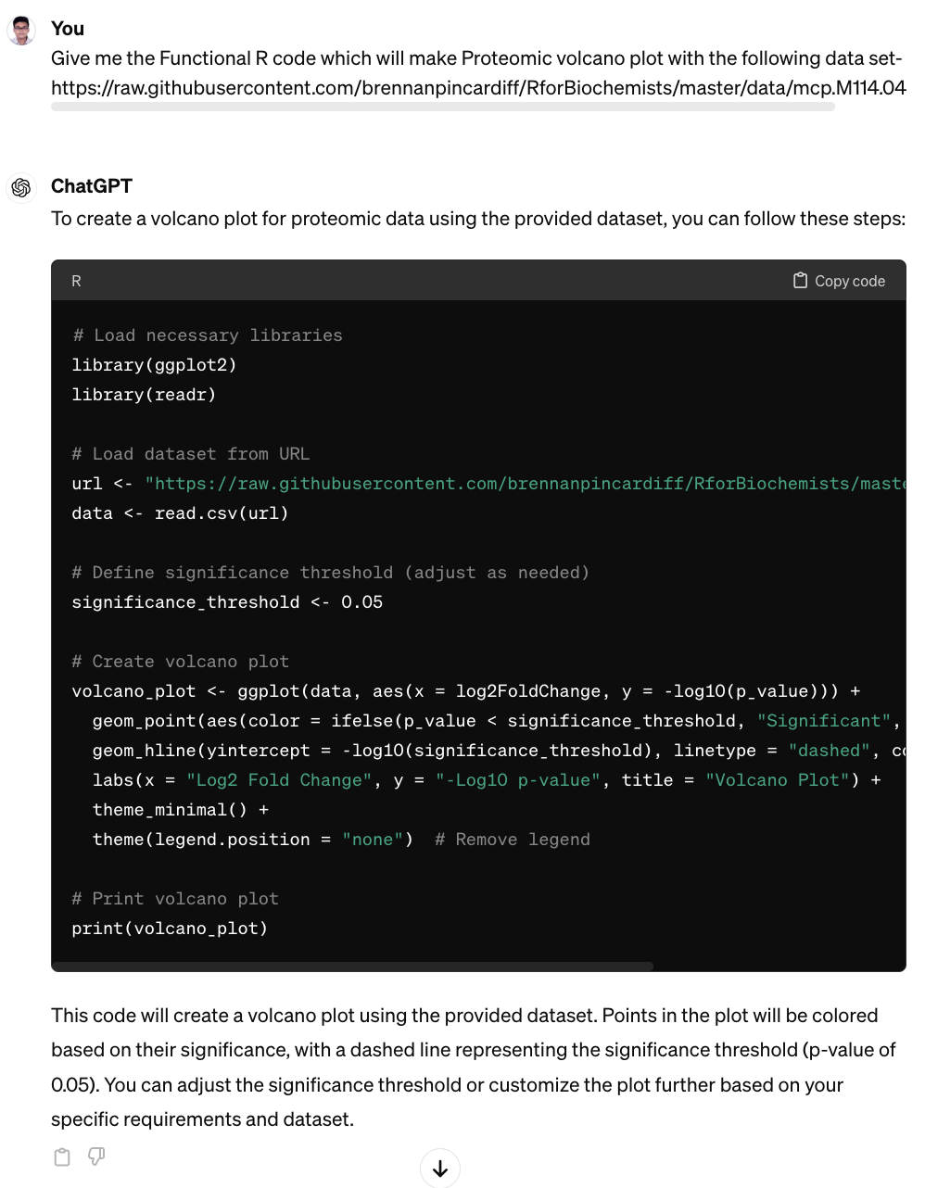
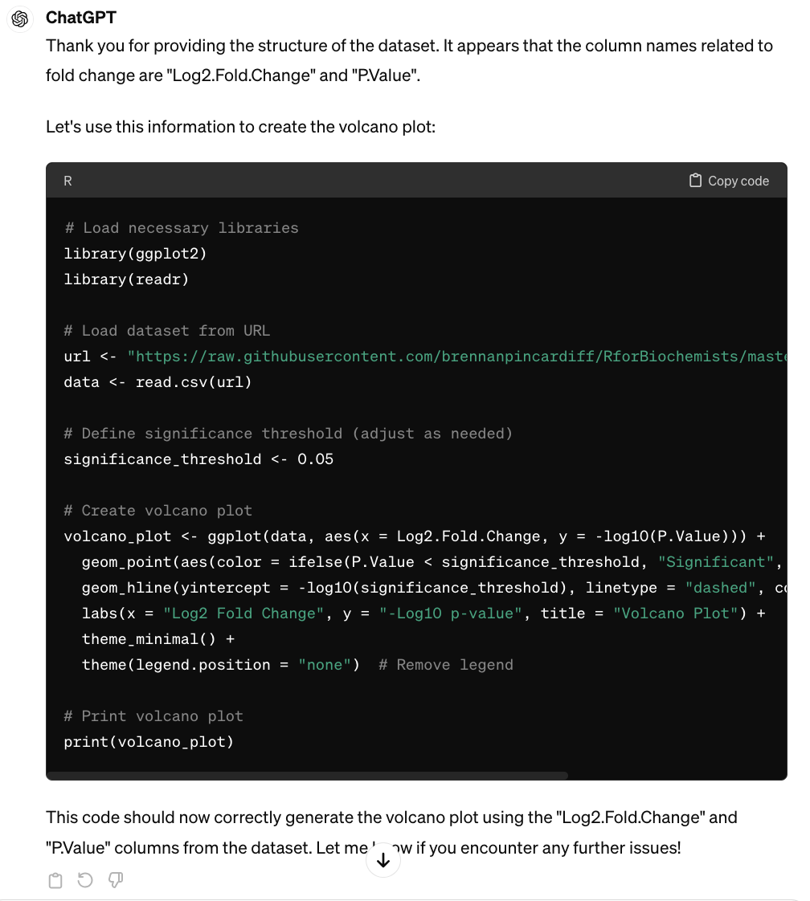
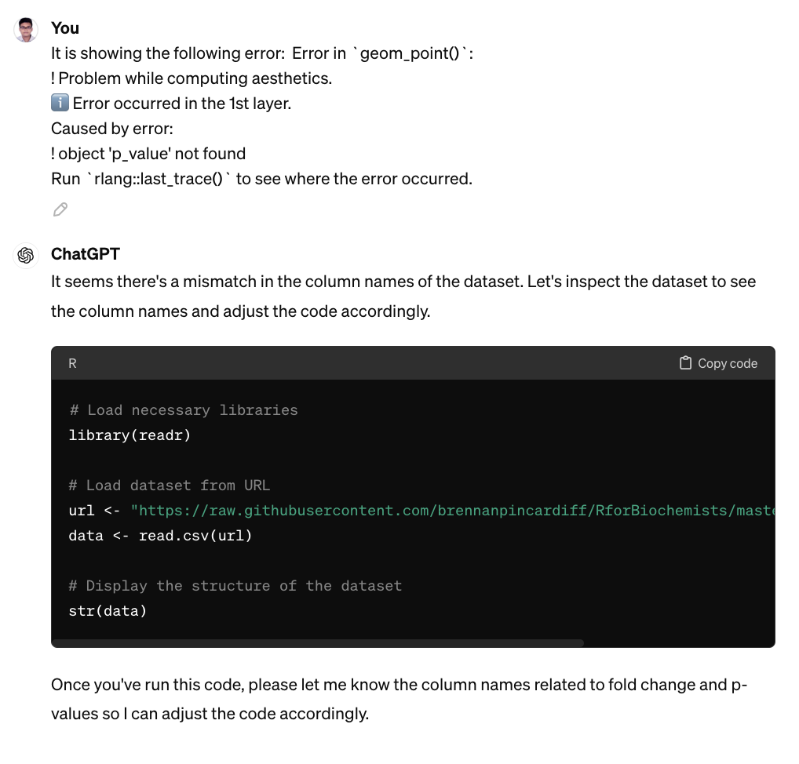

Slide 9

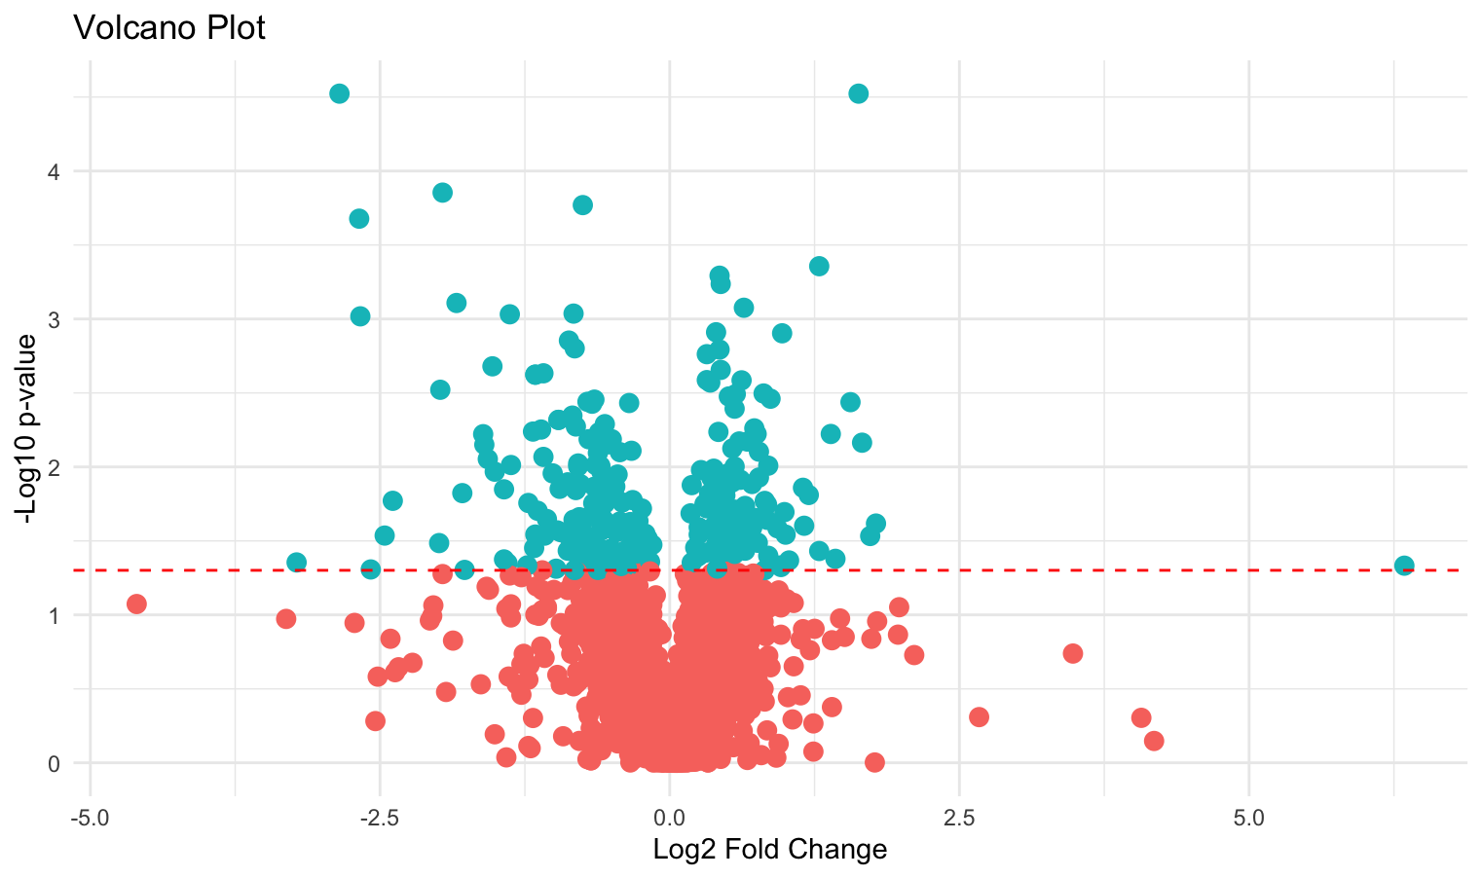

Slide 10
Take Home Message
To get a functional code from ChatGPT for a specific analysis, you need to feed the data set and elaborate your question/prompt as specifically as possible.
You need to provide the full error response (which you are getting from the R console) in ChatGPT to get the most desired result
Most importantly, you need to pray so that ChatGPT can give you the correct functional code 🥲

Slide 11
References
1. Eagle, G. L., Zhuang, J., Jenkins, R. E., Till, K. J., Jithesh, P. V., Lin, K., ... & Pettitt, A. R. (2015). Total Proteome Analysis Identifies Migration Defects as a Major Pathogenetic Factor in Immunoglobulin Heavy Chain Variable Region (IGHV)-unmutated Chronic Lymphocytic Leukemia*[S]. Molecular & Cellular Proteomics, 14(4), 933-945
2. Alsagaby, S. A., Khanna, S., Hart, K. W., Pratt, G., Fegan, C., Pepper, C., ... & Brennan, P. (2014). Proteomics-based strategies to identify proteins relevant to chronic lymphocytic leukemia. Journal of proteome research, 13(11), 5051-5062
3. https://rforbiochemists.blogspot.com/2015/06/drawing-proteomic-data-volcano-plot.html
4. R Core Team. 2024. R: A Language and Environment for Statistical Computing. from https://www.r-project.org/
5. Ye, H., Shen, X., Li, Y., Zou, W., Hassan, S. S. U., Feng, Y., ... & Zhu, W. (2024). Proteomic and metabolomic characterization of bone, liver, and lung metastases in plasma of breast cancer patients. PROTEOMICS–Clinical Applications, 2300136.
6. Jenkins, S. F., Magill, C. R., & McAneney, K. J. (2007). Multi-stage volcanic events: A statistical investigation. Journal of Volcanology and Geothermal Research, 161(4), 275-288.

Slide 12


